Slide 1
Demo 1 Presentation
Group 4: Bailey Oteri, Jordie Weber, Trevor Wolf, Daxton Garner

Slide 2



Final Objectives:
- Create moving robot using Raspberry PI and Arduino
- Simulating search and rescue robots using arUco markers
- Robot searches unknown area using 6 markers as a path

Slide 3
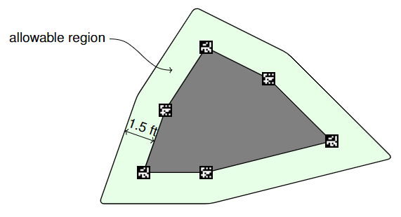
Introduction
In this example course, the greyed-out region is the unknown area, with 6 markers along the outside. Hopefully, our robot will use these markers and their location as a way of directions and move along the outline of the unknown area, not to be more than 1.5 feet away from it.

Slide 4

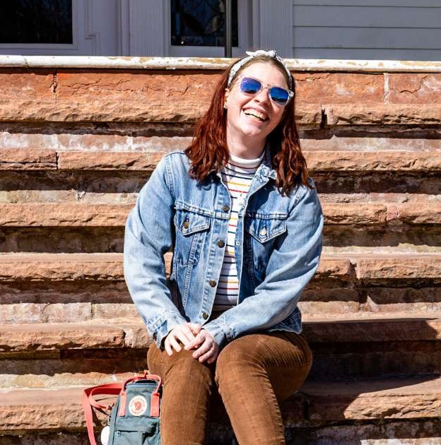
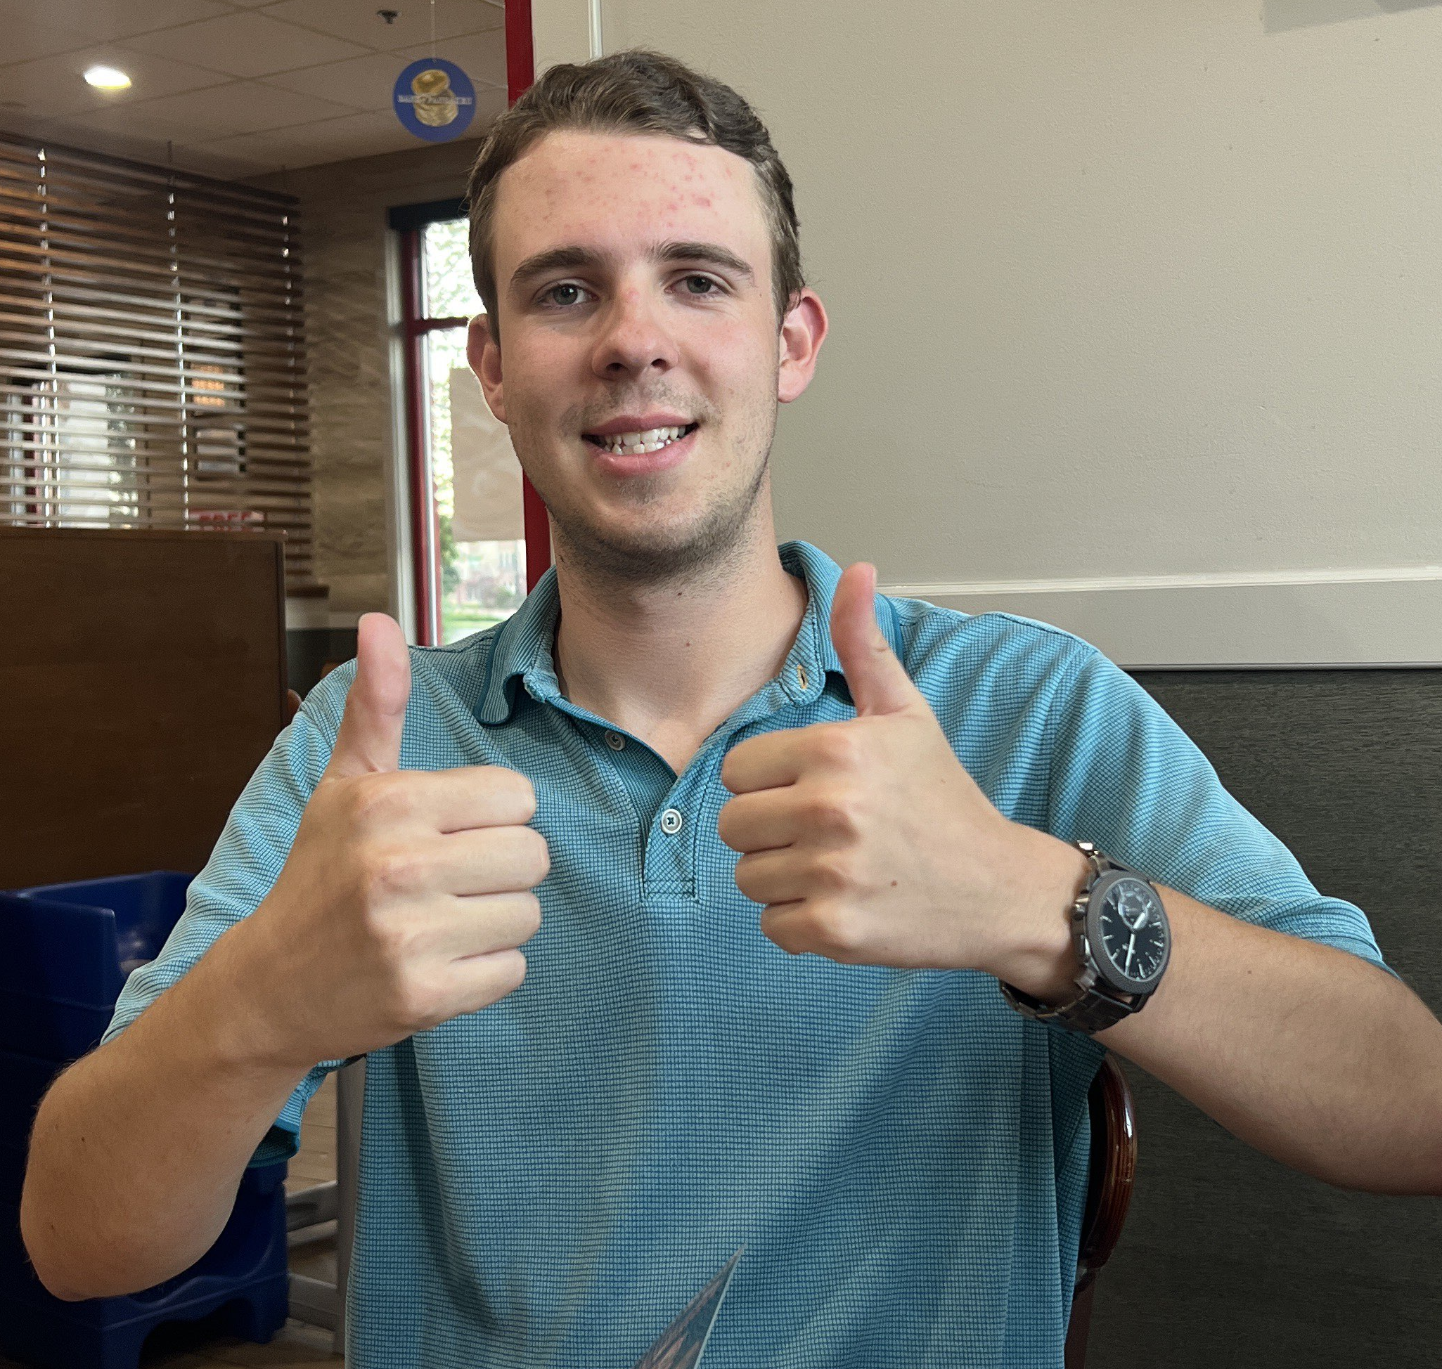

Our Team: Lightning McSEED
Bailey Oteri
Jordie​ Weber
Trevor Wolf​
Daxton Garner
System Integration
Computer Vision
Localization
Control

Slide 5
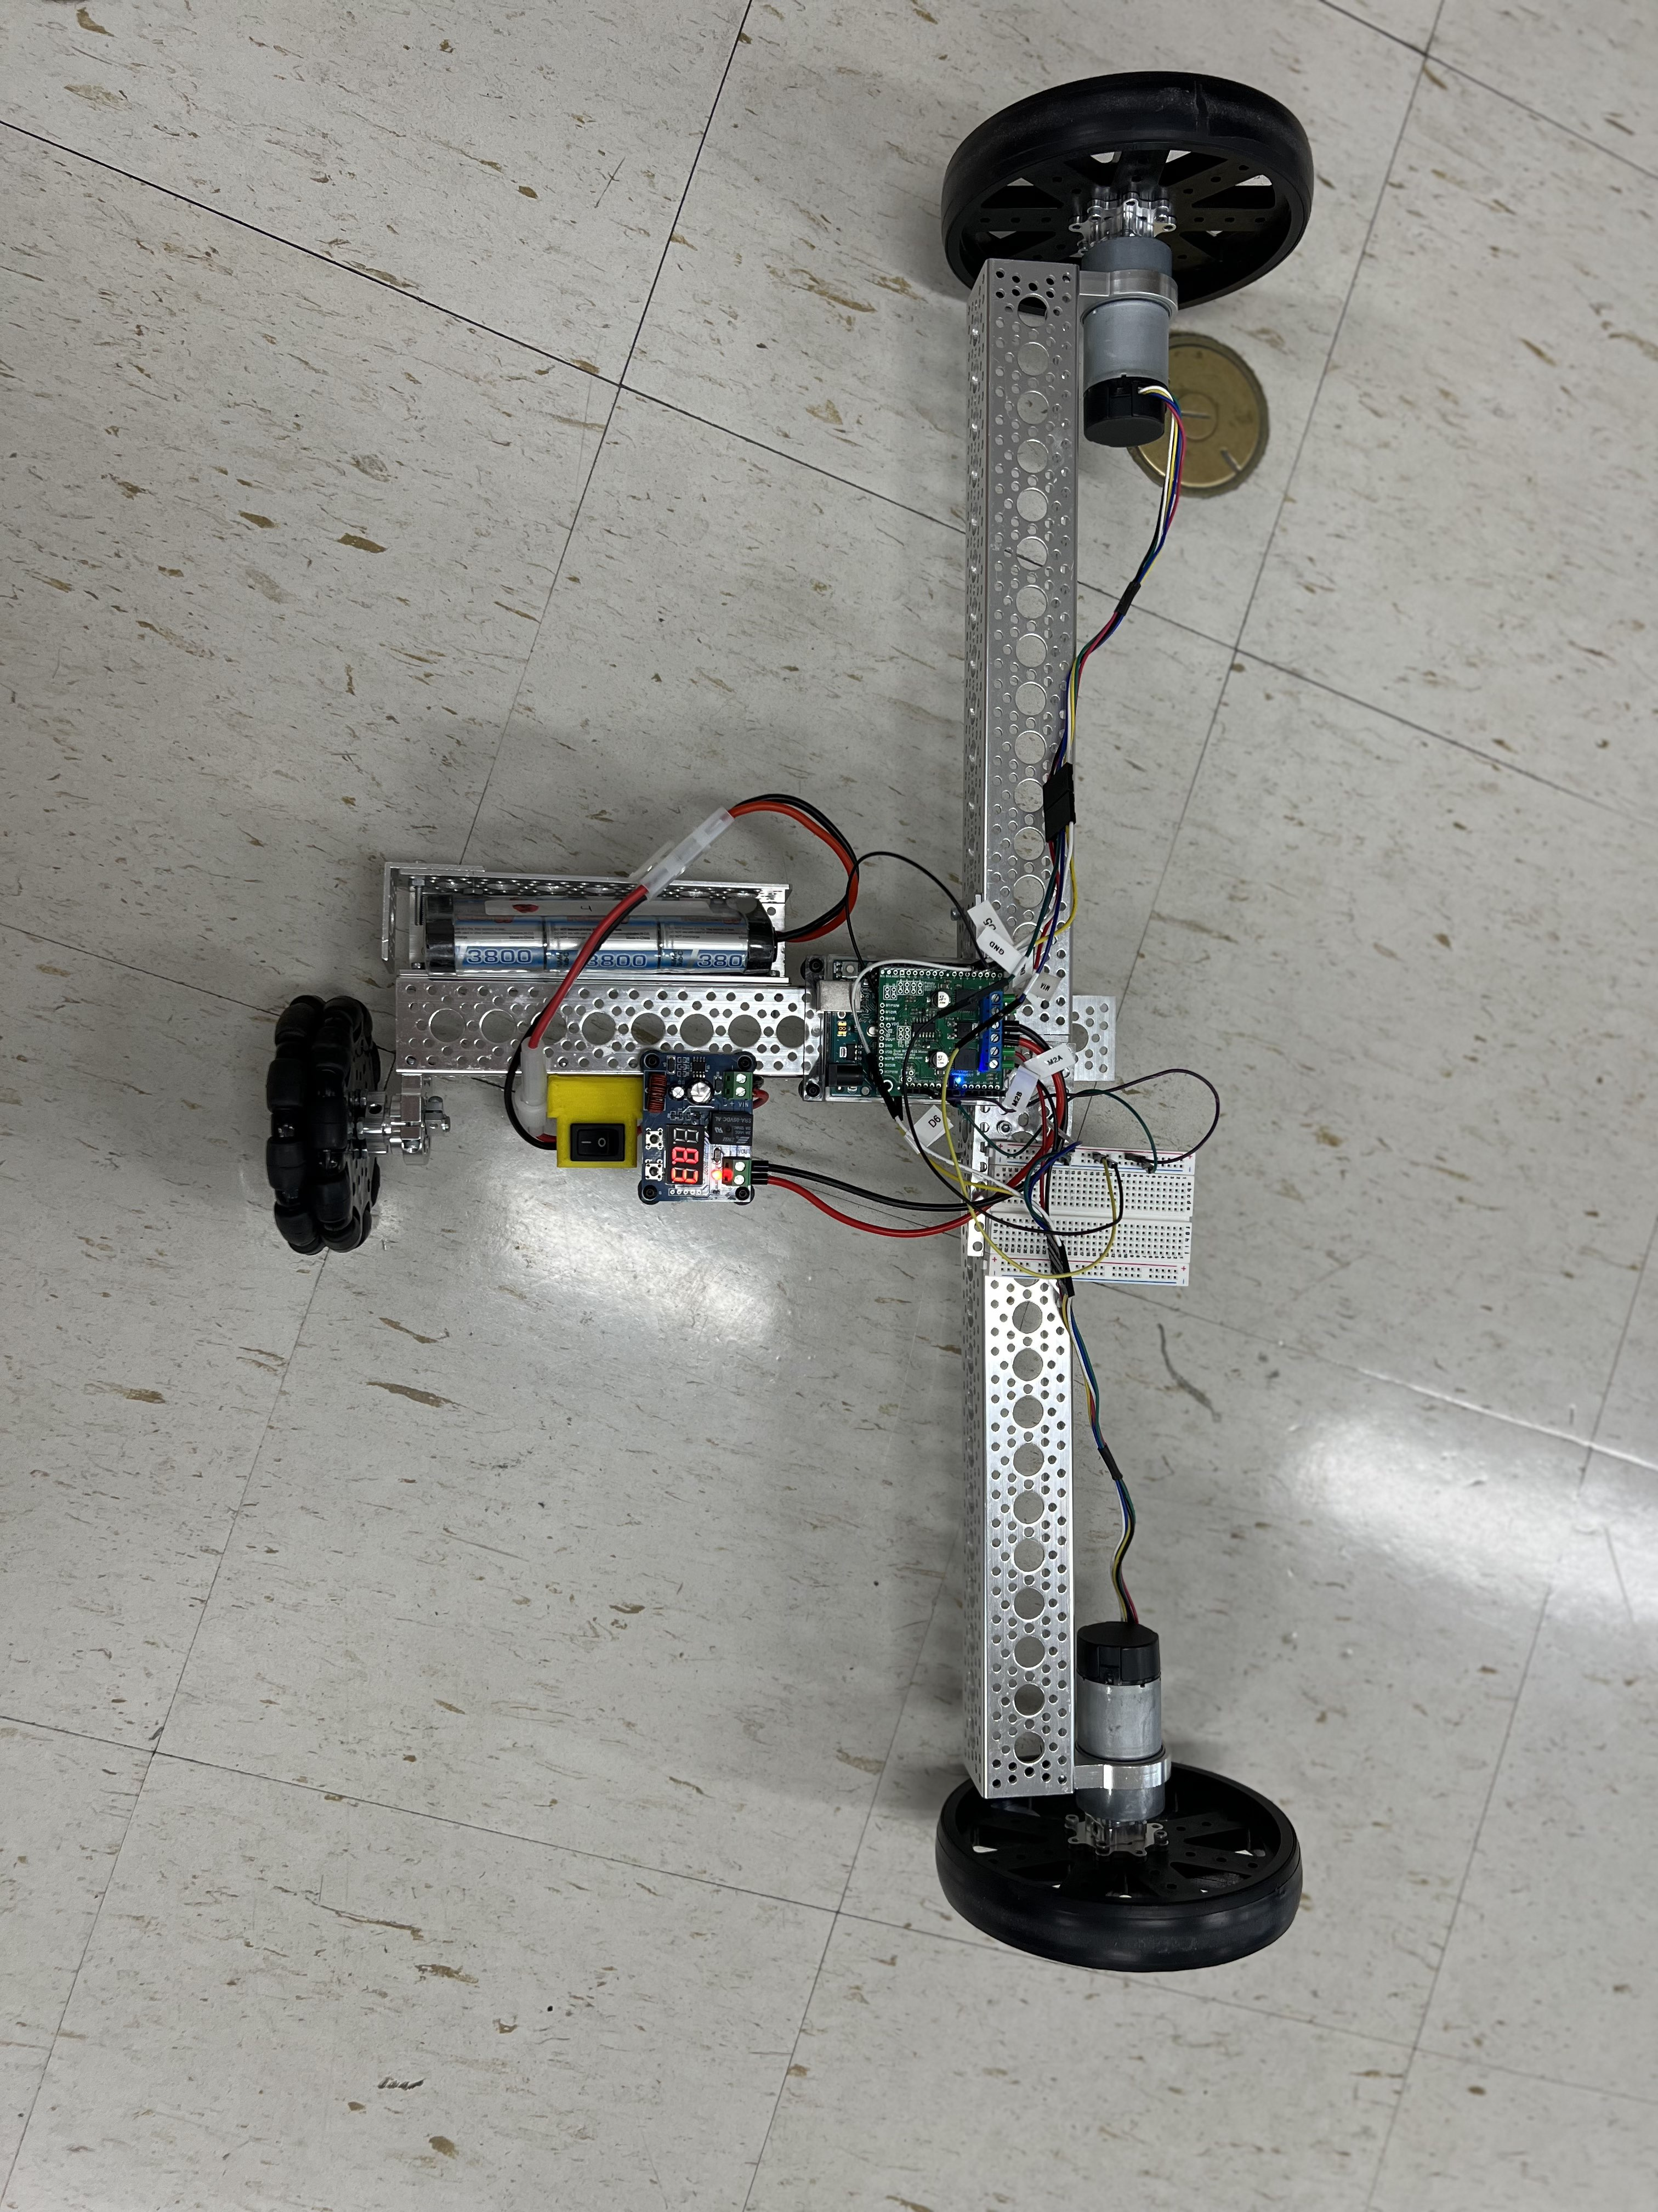
Our Robot!

Slide 6
Hardware design concept design – Trevor add!

Slide 7
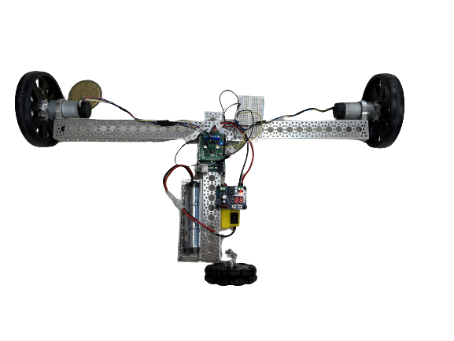
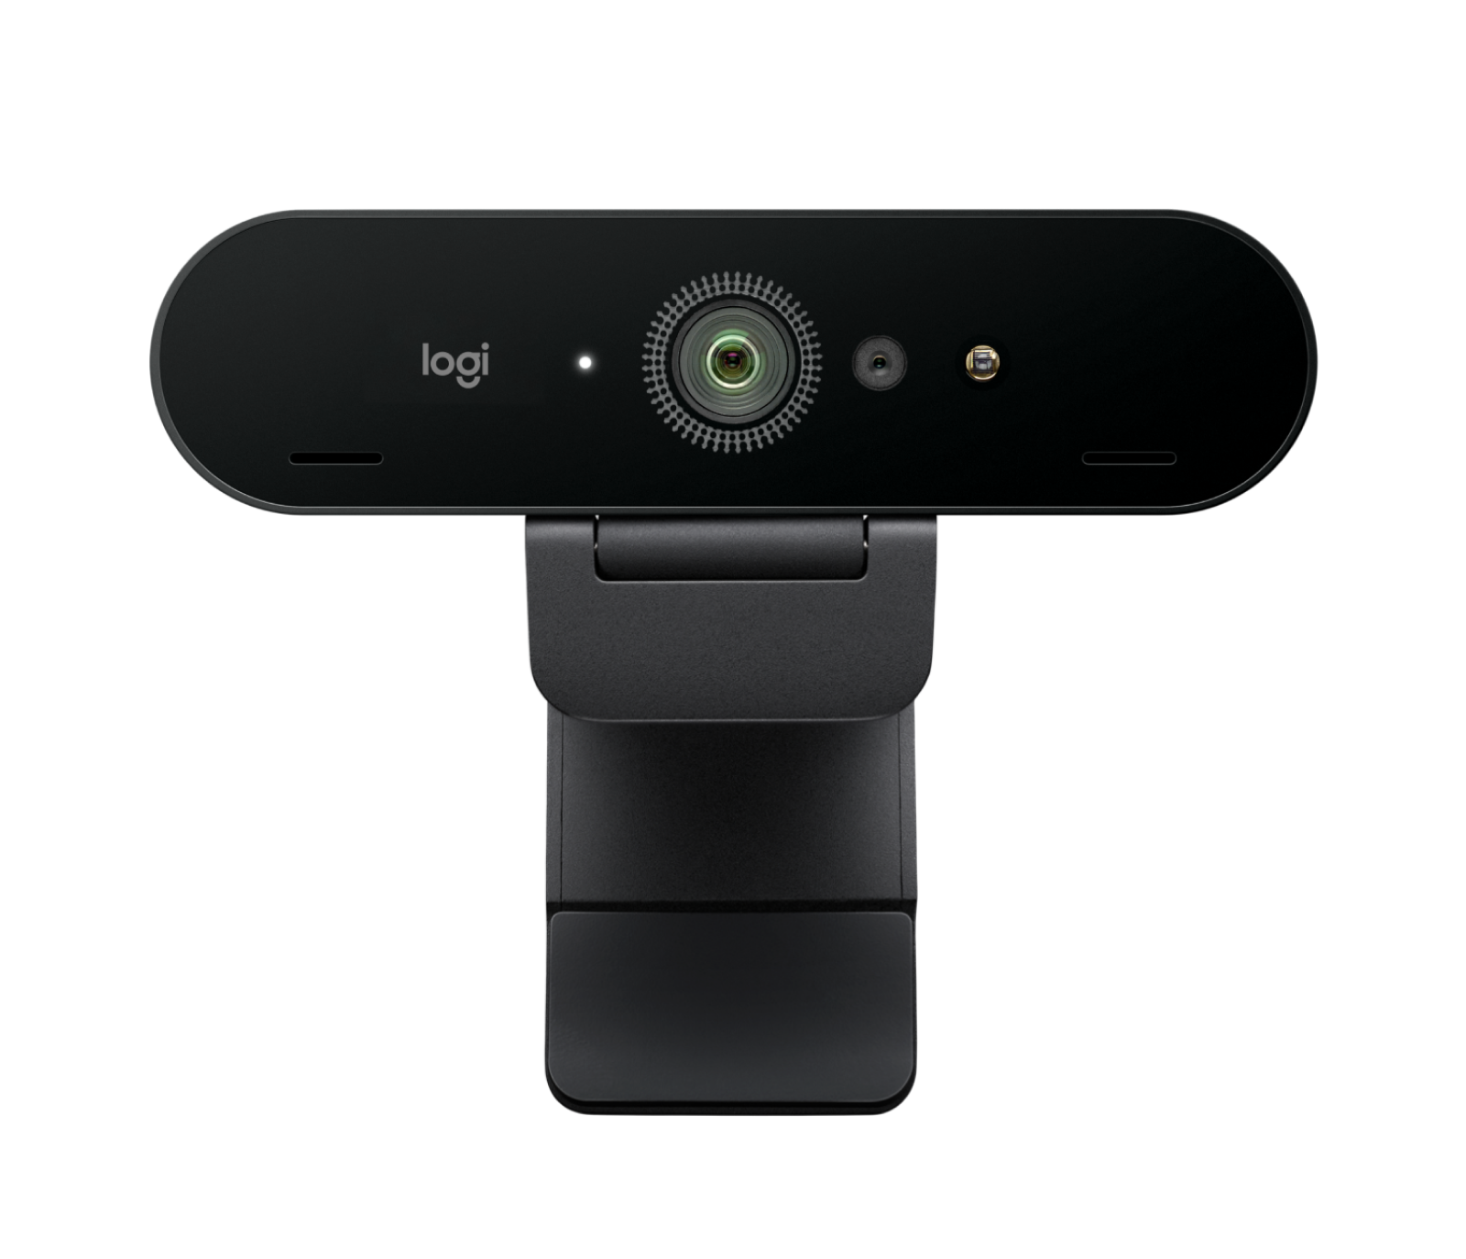

Detection of ArUco markers
Our Raspberry PI used a camera to detect where the ArUco markers were. It then uses trigonometry functions to find the angle between the current path of the robot and the marker to determine if the robot needs to turn.
The PI will then send this information to the Arduino using I²C communication.
The PI is also using I²C to print to the LCD screen on top of the PI.
$$θ$$

Slide 8
Explain how Arduino controls robot

Slide 9
Project Timeline
Final Demonstration
Assignment #1
October 23, 2023
Demo #1
November 10, 2023
Demo #2
December 4, 2023
Explain demo
Detect ArUco marker and find angle between camera and marker
Move robot forward in strait line and rotate by designated radius
Assignment #2
Rotate robot wheel by designated radius specified by PI from location of ArUco marker
Communicate between camera, Rasberry PI, LCD screen, and Arduino

Slide 10
Areas of growth
 | B2B | Supply chain | ROI | E-commerce
Q1 | 4.5 | 2.3 | 1.7 | 5.0
Q2 | 3.2 | 5.1 | 4.4 | 3.0
Q3 | 2.1 | 1.7 | 2.5 | 2.8
Q4 | 4.5 | 2.2 | 1.7 | 7.0

Slide 11








Meet our extended team
Takuma Hayashi​
Mirjam Nilsson​
Flora Berggren​
Rajesh Santoshi​
President
Chief Executive Officer
Chief Operations Officer
VP Marketing
Graham Barnes
Rowan Murphy
Elizabeth Moore
Robin Kline
VP Product
SEO Strategist
Product Designer
Content Developer

Slide 12
Areas of focus
B2B market scenarios
Develop winning strategies to keep ahead of the competition
Capitalize on low-hanging fruit to identify a ballpark value
Visualize customer directed convergence
Cloud-based opportunities
Iterative approaches to corporate strategy
Establish a management framework from the inside

Slide 13
How we get there
ROI
Niche markets
Supply chains
Envision multimedia-based expertise and cross-media growth strategies
Visualize quality intellectual capital
Engage worldwide methodologies with web-enabled technologies
Pursue scalable customer service through sustainable strategies
Engage top-line web services with cutting-edge deliverables
Cultivate one-to-one customer service with robust ideas
Maximize timely deliverables for real-time schemas

Slide 14
Summary
At Contoso, we believe in giving 110%. By using our next-generation data architecture, we help organizations virtually manage agile workflows. We thrive because of our market knowledge and great team behind our product. As our CEO says, "Efficiencies will come from proactively transforming how we do business."

Slide 15
Thank you
Mirjam Nilsson​
mirjam@contoso.com
www.contoso.com

